Slide 1
Resilience through Integration?
Industrial Policy and India's Mobile Phone Industry in Global Value Chains
C. Veeramani
Centre for Development Studies, Thiruvananthapuram
RIETI-ANU Symposium | 8 October 2026
Session 1: Supply Chain Resilience in an Era of Uncertainty
Notes:
~30 sec. Framing question for the talk: can industrial policy build resilience by integrating into GVCs rather than by localising everything? India's mobile phone industry is a natural test because it tried both routes in sequence.

Slide 2
Industrial Policy (IP) is back, and resilience is a stated goal
4,000+
500+
14
trade-distorting industrial policy measures, Jan 2023 – Jun 2024
new industrial policies in emerging & developing economies, 2023
sectors covered by India's PLI schemes
Stated motives: resilience, national security, geopolitics.
Sources: Evenett et al. 2024; Juhász, Lane & Rodrik 2024; World Bank 2024
Notes:
~1 min. IP is back everywhere: CHIPS Act, IRA, Made in China 2025, India's PLI. Key point for this panel: resilience is now one of the explicit motives, alongside security and geopolitics. Those motives are not market-failure arguments, so the question is whether IP in their name delivers anything. (Optional: 4,000+ measures, 71% of 2023 IP trade distorting; tit-for-tat subsidy races are themselves a source of uncertainty.)

Slide 3
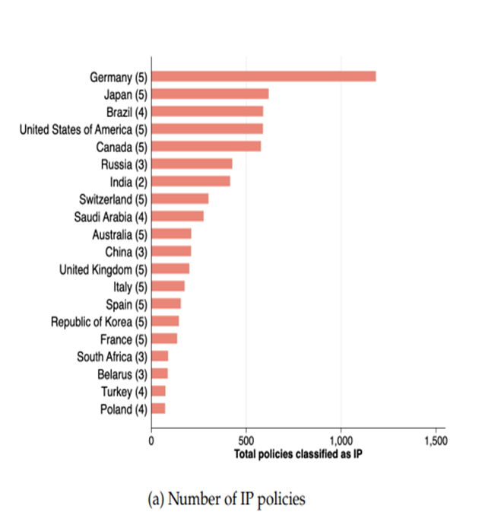
IP Is Back - Everywhere
India
Source: Juhasz et al (2023) based on textual analysis of the GTA database

Slide 4
IP: Concept, Rationale and Practice
Definition
  Strategic state action directed at changing the structure of the economy
Economic rationale
  IP is justified if markets on their own fail to allocate resources efficiently
  Market failure → infant industry argument, knowledge spillovers, dynamic scale economies, coordination failures, credit market imperfections and informational externalities
  IP in practice
  Often associated with factors that are not related to market failures
  Resilience, local value addition, strategic or geopolitical competition, retaliation, national security, technological leadership, good jobs, climate transition, balanced regional development etc

Slide 5
Costs of Misplaced IP
Resource misallocation and inefficiency
Rent seeking
  Lobbying power of established constituencies is an important determinant of IP (Juhasz et al, 2022; Evenett, et al, 2024)
Retaliatory dynamics or tit-for-tat response
  Positive correlation between new IP and past IP measures by other countries in the same sectors (Evenett, et al, 2024)
  A subsidy for a given product by one economy is met with a subsidy for the same product by another within one year (73.8% probability)
Trade tensions
  Negative spillover effects on trading partners
  71 percent of IP in 2023 were trade distorting (Evenett, et al, 2024)
“The best industrial policy is none at all.” (Gary Becker, 1985)

Slide 6
Saving IP from its Advocates
Old IP | New IP in the Era of GVCs
Focus on developing an integrated domestic production structure | Specialization in specific segments of GVCs Activities where the country has a comparative advantage India → backward linked GVCs Assembly of final products for global markets using imported inputs
Protection of domestic markets through high import barriers | Easy and low-cost access to imported intermediate inputs
Building of domestic capacity with the goal of eventually exporting and competing with global MNEs | Exports is not the end goal, but the starting point Lead firms (MNEs) drive GVCs IP aims to integrate local firms into GVCs.
Future growth contingent on the industry attaining global competitiveness | Growth strategy revolves around GVC upgrading Moving into higher-value tasks over time Development of domestic brands and champions

Slide 7
Two routes to supply chain resilience
Self-reliance
Integration
Aim: localise production and inputs
Tools: tariffs, local content rules
Metric: DVA ratio
Risk: high costs, small scale
Aim: add production locations
Tools: output subsidies, open input imports
Metric: absolute DVA, export scale
Risk: import dependence, low-end lock-in
India's mobile phone policy tried both, in sequence.
Notes:
~1.5 min. This is the organising idea. Resilience can mean self-reliance (localise, cut imports, raise the DVA ratio) or diversification (more locations, so no single country is a chokepoint). They call for different tools and are judged by different metrics. India tried the first with the PMP from 2016, then switched to the second with NPE 2019 and PLI 2020.

Slide 8
India’s Mobile Phone Industry
Two phases of growth in India’s Mobile phone manufacturing industry
Phase 1 (2016-17 to 2018-19):
  Phased Manufacturing Programme (PMP) focused on import substitution
  Led to growth in assembly and localization of components
  Aimed at meeting domestic demand, with limited export impact
Phase 2 (2019–20 onwards):
  Shift to export-oriented strategy under National Policy on Electronics (NPE) 2019 and PLI scheme (2020)
  Targeted deeper GVC integration and global competitiveness
  Marked a strategic shift from import substitution to export-led growth

Slide 9
Old Vs New IP: India’s Mobile Phone Manufacturing
 | Old IP: PMP in 2016 | New IP: NPE and PLI in 2019
Objective | To boost domestic production through import substitution. | To position India as a global manufacturing hub, emphasizing integration with GVCs and exports.
Policy instrument | High import tariffs for final mobile phones and components, alongside local content requirements. | Targeted subsidies under the PLI
Key Players | Smaller Indian and Chinese companies. | Lead firms like Apple and Samsung
Outcomes | Domestic production increased to around $20 billion in 2017. Exports remained negligible, at just $0.1 billion. | Second-largest mobile phone producer globally. Production surged from $0.26 billion in 2014 to $60 billion in 2024. Exports increased from $334 million in 2017 to $24.1 billion by 2024. Sharp decline in imports. Net exporter of mobile phones since 2018

Slide 10
Mobile phone production increased over 20x between 2014-15 and 2024-25
  Growth driven primarily by exports - outpaced domestic demand
  India has emerged as the world’s third-largest manufacturing-based exporter
Imports have declined sharply
India became a net exporter of mobile phones since 2018-19
Output and exports held through COVID

Slide 11
Phase 1 (2016–17 to 2018–19)
  Focus on import substitution under the PMP
  Phase 2 (2019–20 to 2022–23):
    Shift to GVC driven growth under the National Policy on Electronics 2019 and the PLI scheme

Slide 13
Decomposition of Gross Exports of Mobile Phones into DVA and FVA
Gross Value of Output = DVA + FVA
FVA: value added generated in other countries due to foreign linkages (imports).
The share of DVA in output increased from an average of 8.8% in Phase 1 to 22.2% in Phase 2

Slide 15
Takeaway: resilience through integration, not autarky
Scale before the DVA ratio: a large, growing absolute DVA creates more jobs and income than a high ratio in a small, protected industry.
China and Vietnam started with low DVA ratios and scaled first
Local content rules raise costs, cut exports, and can lower absolute DVA
Implication: aim to be a large node in diversified GVCs, not a self-sufficient island
Success in mobile phones provides a blueprint for the broader electronics sector
Notes:
~1.5 min. Main lesson. The implication line is an argument the evidence supports indirectly rather than a tested result; present it that way. End on the open question to hand over to discussion.

Slide 16
Thank You

Slide 17
Backup: Estimating DVA, Job Creation & Income Growth
Direct effects estimated using:
  Plant-level data from the ASI
  Measures include value added, employment, and wage income
Indirect effects captured through:
  Construction of Domestic Use Tables (DUTs) using highly disaggregated ASI data
  DUTs reflect purchases between over 5,000 product sectors (7-digit NPCMS level)
  Covers the period 2016–17 to 2022–23
Technical Coefficient Matrix (TCM):
  Derived from DUTs
  Shows input requirements between product sectors - i.e., technological dependencies
Leontief Inverse:
  Calculates economy-wide ripple effects of mobile phone production
  Captures job and income impacts across upstream industries (e.g., sub-assemblies, components)

